Slide 1



Texas Community Development Block Grant Program
CDBG Over Coffee
Today’s Topic:
Single Audit
Notes:
Good afternoon
Welcome and thank you for joining us for another CDBG Over Coffee, today’s topic, is Single Audit

Slide 2
The Single Audit Act of 1984
  Increased Accountability and Oversight
    Standardizes audit process
    Emphasis on internal control
    Comprehensive entity-wide audits
  Reduced Audit Burden and Improved Efficiency:
    Consolidated audit efforts by optimizing the use of audit resources
  Promotes Sound Financial Management
    Fair presentation of financial position
Notes:
The Single Audit Act of 1984 was a landmark piece of legislation in the United States that significantly reformed the auditing requirements for state and local governments receiving federal financial assistance.
Prior to the Single Audit Act, each federal agency required a separate audit for its own grants. This often resulted in expensive duplication of effort with no uniform audit standards
The Act replaced multiple audits of individual federal programs with a single, comprehensive audit of the non-federal entity's financial statements and all federal awards.

Slide 3
Law, Regulations, and Procedures
  Implementing Regulations: 2 CFR Part 200 Subpart F
  TxCDBG Procedures: Implementation Manual Chapter 14
Notes:
The Single Audit Act of 1984, along with its amendments and subsequent guidance, has played a crucial role in establishing a framework for accountability and transparency in the use of federal funds by non-federal entities.
For more information on the Sigle Audit policies, please refer to the Code of Federal Regulations or Chapter 14 of the TxCDBG Implementation Manual.

Slide 4

Single Audit Thresholds
The threshold has increased over the years:
  1996 - $300,000
  2003 - $500,000
  2013 - $750,000
  2024 - $1,000,000
Notes:
The single audit threshold for federal awards has increased from $750,000 to $1,000,000, effective for fiscal years beginning on or after October 1, 2024. This means that non-federal entities expending less than $1 million in federal funds annually will no longer be required to undergo a single audit.
The higher threshold is designed to reduce the compliance burden on smaller organizations that receive federal funds, allowing them to focus resources on essential public services.

Slide 5
New Threshold
The one-million-dollar threshold will go into effect for local fiscal years beginning on or after October 1, 2024.
Fiscal Year Begin Date | Fiscal Year End Date | Single Audit Due Date | Single Audit Threshold
October 1, 2023 | September 30, 2024 | June 30, 2025 | $750,000
January 1, 2024 | December 31, 2024 | September 30, 2025 | $750,000
April 1, 2024 | March 31, 2025 | December 31, 2025 | $750,000
July 1, 2024 | June 30, 2025 | March 31, 2026 | $750,000
October 1, 2024 | September 30, 2025 | June 30, 2026 | $1,000,000
January 1, 2025 | December 31, 2025 | September 30, 2026 | $1,000,000
Notes:
The new single audit threshold took effect on October 1, 2024. However, your community may not be immediately impacted. The $1,000,000 threshold applies to fiscal periods beginning after this date. As such, changes to the audit threshold will be effective for audits for years ending September 30, 2025, or later as prescribed by the 2024 Office of Management and Budget.

Slide 6
TxCDBG and the OCSAR report
Grant Agreement Start Date
OCSAR Report
End of Fiscal Year
12 Months
OCSAR Report
Project Completion Report
Organizational Compliance Single Audit Report (OCSAR) report
  Grant Recipients with any TxCDBG grant open
  “Open” means at least one day after the Grant Agreement start date, and before the Project Completion Report.
Notes:
Grant Recipients with any TxCDBG grant that was open at any point during the fiscal year must submit an Organizational Compliance - Single Audit Report (OCSAR) in TDA-GO.
For this purpose, “open” means that at least one day in the fiscal year is after the Grant Agreement start date, and before the Project Completion Report is submitted. The OCSAR can be prepared as soon as the day after the fiscal year end of the Grant Recipient’s organization.

Slide 7
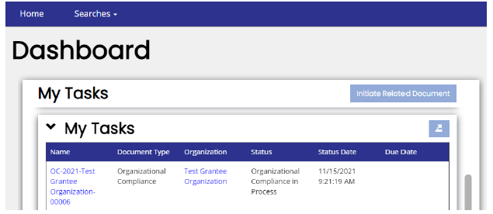

How to Complete the OCSAR In TDA-GO
The outstanding OCSAR will be available in the My Tasks for each Grant Recipient.
Completed by authorized individual.
Identify the Organizational Single Audit Compliance form
Notes:
TDA will create the OCSAR on behalf of each Grant Recipient required to complete the document. For 2025, we will create a form using the appropriate threshold ($750,000 or $1 million) based on the fiscal year end recorded in your Organization Profile. The following slides will use the $750,000 threshold for our examples – if your next audit is subject to the $1 million threshold, the screens will be similar but updated for the new dollar amounts.
Launch TDAGO and login with your username and password.
Each outstanding OCSAR will be available in the My Tasks section of the Dashboard for each Grant Recipient user with an Authorized Official and Project Director role.
The OCSAR can also be found by using the Search menu and selecting Organizational Compliance.
The OCSAR must generally be completed by a member of the Grant Recipient organization who is designated and authorized by resolution to certify payment requests.
The Grant Recipient may invite their certified public accountant firm to create a TDA-GO account and may be granted access to the document. Submit a TDA-GO Support Ticket to request this access.

Slide 8
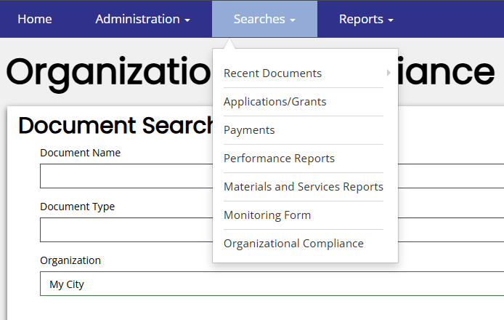
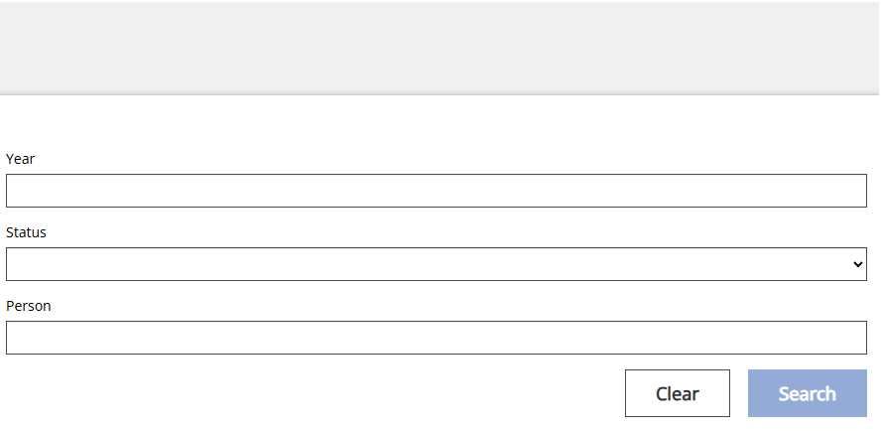
How to Complete the OCSAR In TDA-GO
Notes:
Another way to access the OCSAR report is by:
Selecting Search on the blue bar
From the drop-down menu, select Organizational Compliance
Once the page, type in the city or county name, and
Click on search

Slide 9

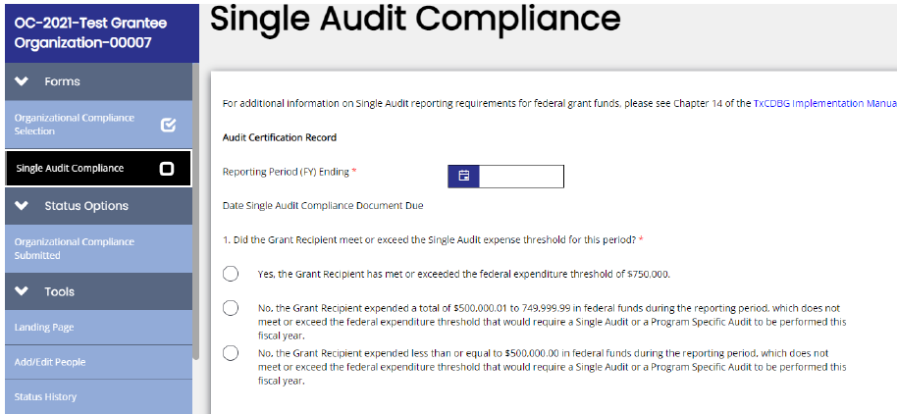
Complete the Threshold Questions
For expenditures less than $500,000
TDA enters the FYE date for communities.
Notes:
Using the Navigation Pane on the left side of the screen, select the page marked “Single Audit Compliance.” Answer questions in parts 1 and 2 of the Audit Certification Record to determine whether a full accounting of all expenditures is required by TDA for a given fiscal year. Note that TDA enters the FYE date for communities.
If the OCSAR does not require additional information or documentation, Click Save and Submit OCSAR report.
Best Practice – if your community did not exceed the expenditure threshold, complete and submit the OCSAR as soon as possible! There is no need to wait until the deadline and risk having funds placed on hold if you are late.

Slide 10
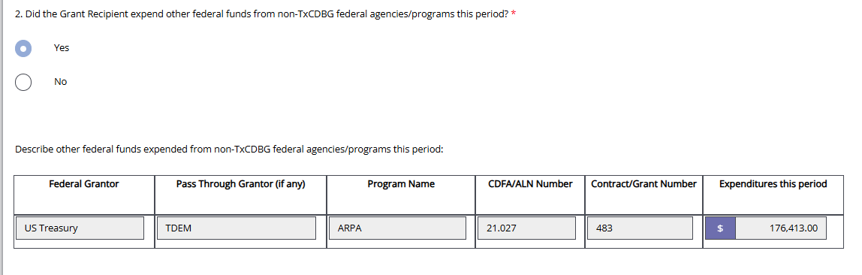
Complete the Threshold Questions
For expenditures that exceed $500,000 but less than $750,000
Report other federal funds expended from non-TxCDBG federal agencies/programs
Notes:
If federal grant expenditures during the fiscal year exceed $500,000 but are less than the Single Audit threshold, OR if federal grant expenditures occurred in multiple programs, TDA requires additional information. Provide data detailing non-CDBG federal awards and expenditures during the fiscal year. Include the following information for both TxCDBG grants and all other federal grants open during the fiscal year: Federal grantor
Pass Through Grantor (if any)
Program Name
CFDA/ALN Number
Contract/Grant Number – Enter the number assigned by the funding agency to identify the specific grant award
Expenditures this period – Enter the amount of grant funds for which expenditures were incurred
Once completed, click Save and Submit the report.

Slide 11
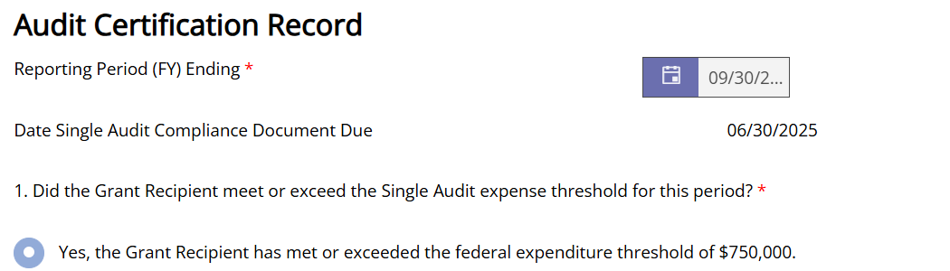
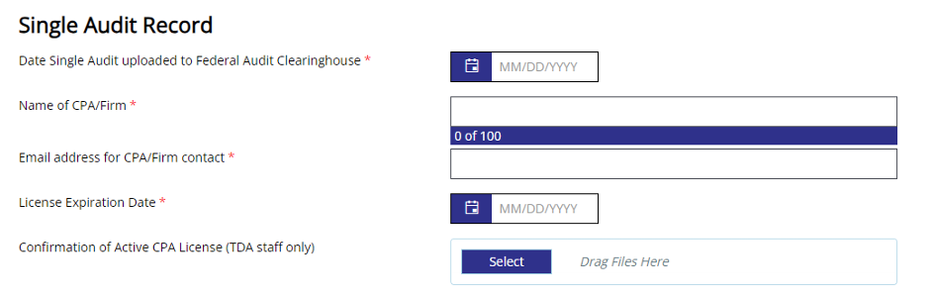
Single Audit Record
For expenditures of $750,000 or more
Notes:
When the grant recipient reports expenditures that meet or exceed the 750K threshold, then the Assessment of Risk must be completed before submitting OCSAR.
If the OCSAR threshold questions indicate a Single Audit is required, additional sections of the form will be made visible. The OCSAR will remain “In Process” until the Single Audit federal requirements are complete and satisfactorily reported in this section. Data with red asterisks are required fields. The “Confirmation of Active CPA License” section is for TDA use only.

Slide 12
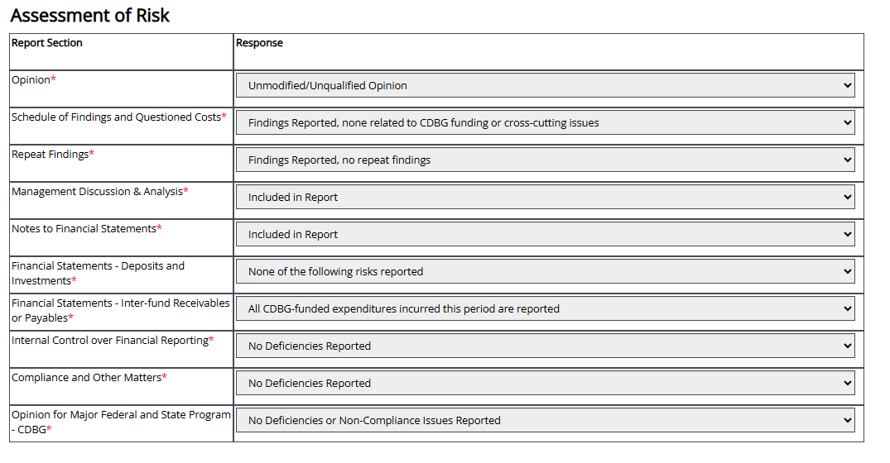
Complete Assessment Risk
Assessment of Risk table with drop-down responses
Notes:
The OCSAR includes a risk assessment for communities required to submit a Single Audit.
• Enter responses necessary for TDA to assess risks identified by the audit. Click the drop-down arrow to select a response to the questions. It is important that these risk assessment questions are answered accurately and the responses match the information we will see in the Audit itself.

Slide 13
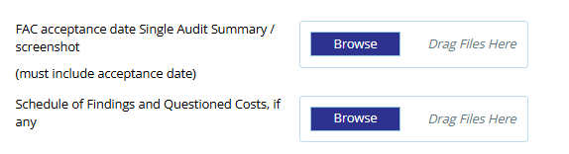
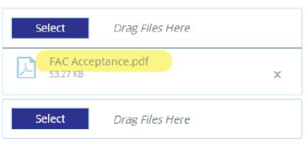
Evidence of FAC Acceptance
Screenshot MUST show the date acceptance.
https://www.fac.gov
Notes:
The OCSAR includes a risk assessment for communities required to submit a Single Audit.
Enter required information to document that the required Single Audit has been submitted to the Federal Audit Clearinghouse.

Slide 14

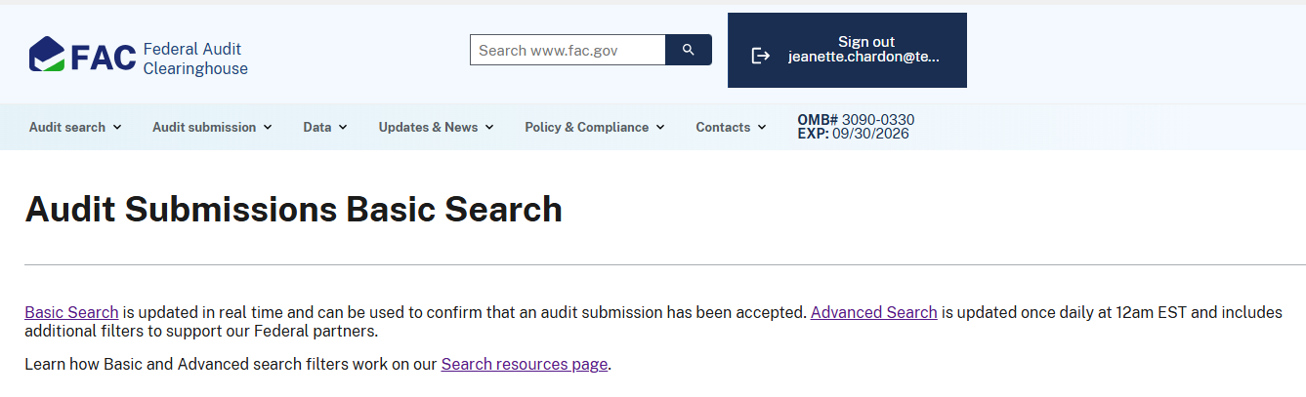
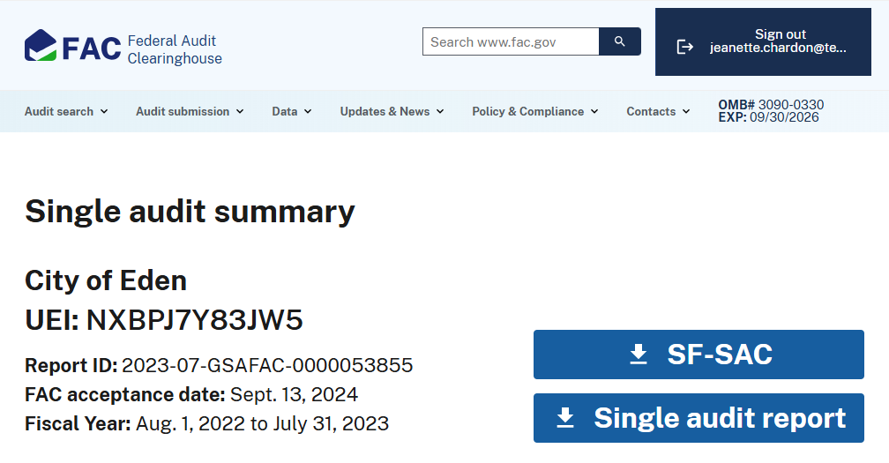
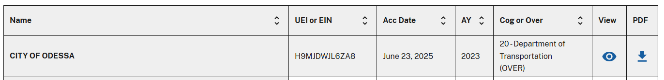
Search Single Audit Reports
Click on the eye icon to view the Single audit summary page
Sample of screenshot to be uploaded in TDAGO
City or County Name
000000000
April 25,02025
Over-21
Federal Audit Clearinghouse at https://www.fac.gov.
Notes:
How to get the screen shot.

Slide 15
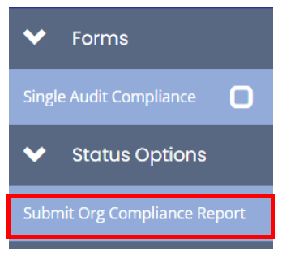

Submit the OSCAR
By submitting the OCSAR, the preparer confirms its accuracy and completeness
…..to Click the SAVE button
Notes:
By submitting the OCSAR, the preparer confirms its accuracy and completeness.
Once the form is completed, please make sure to click on the Save button.
And to submit the document, find the Status Options section of the navigation menu and select Submit Org Compliance Report.

Slide 16

Did you Conduct a Single Audit Correctly?
Consider the Audit Threshold in TDAGO.
Procure an Auditor
Review Financial Documents
Prepare Opinion and Findings
Submit Single Audit to the Federal Clearinghouse
Submit the OCSAR in TDAGO
7. Retain Audit Work Papers
Notes:
These are the steps founding Chapter 14 to describe the Single Audit requirements for communities that exceed the threshold. A few reminders:
Procure an Auditor: If a single audit is required, the audit must be conducted by a Certified Public Accountant (CPA) who has a current license issued by the Texas State Board of Public Accountancy.
Prepare Opinion and Findings: The CPA must provide an opinion on the audit. TDA will not accept the submission of any audits containing a disclaimer of opinion from the auditor for the overall financial statement audit.
Submit Single Audit to Federal Audit Clearinghouse: The SA report must be submitted to the Federal Audit Clearinghouse - NOT to TDA - within nine (9) months after the Grant Recipient’s fiscal year end.
Submit OCSAR in TDAGO: The OCSAR must be submitted in TDA-GO within the same nine (9) month period. This notifies TDA that you have complied and we will download your audit from the clearinghouse as needed.

Slide 17
Thank You For Your Attention
Time for Questions

